Slide 1
Chapter 3
Random Variables and Probability Distributions

Slide 2
Section 3.1
Concept of a Random Variable

Slide 3
Definition 3.1

Slide 4
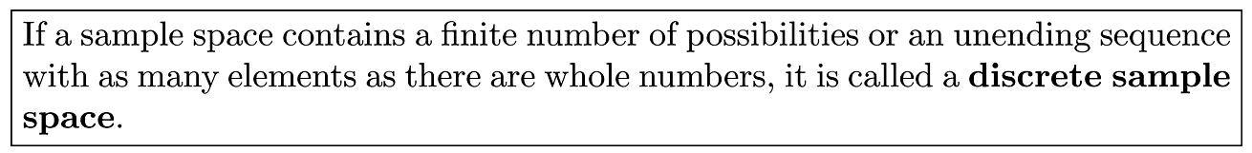
Definition 3.2

Slide 5
Definition 3.3

Slide 6
Section 3.2
Discrete Probability Distribution

Slide 7
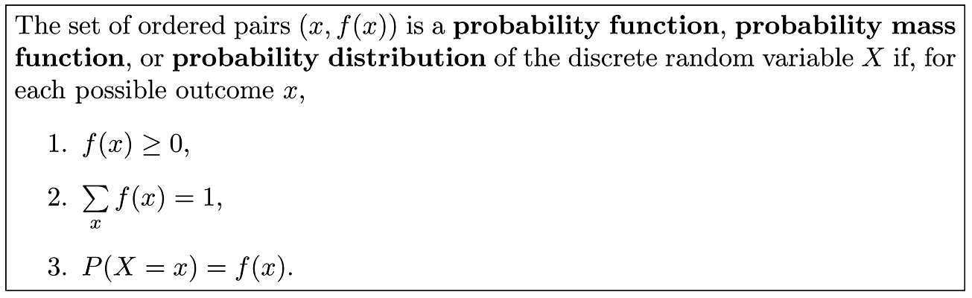
Definition 3.4

Slide 8
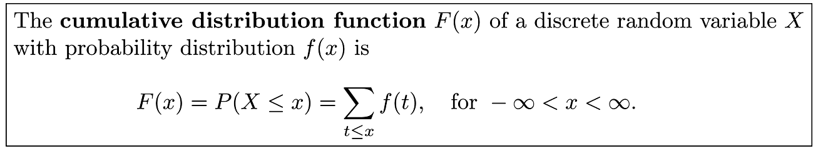
Definition 3.5

Slide 9
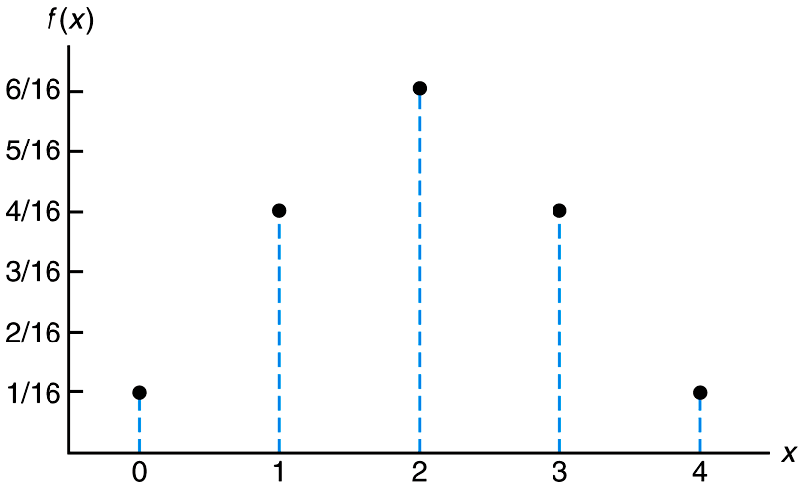
Figure 3.1 Probability mass function plot

Slide 10
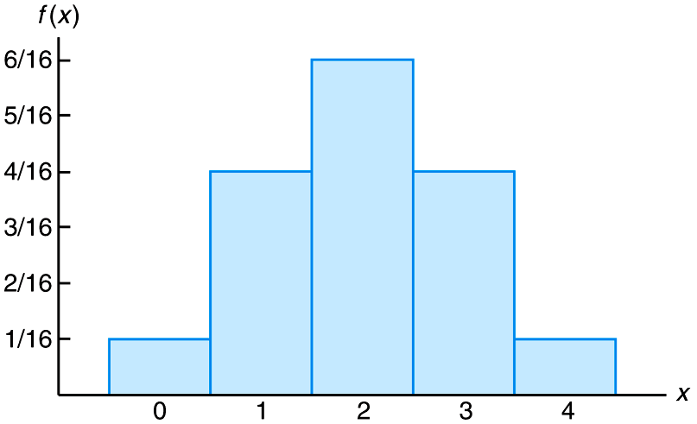
Figure 3.2 Probability histogram

Slide 11
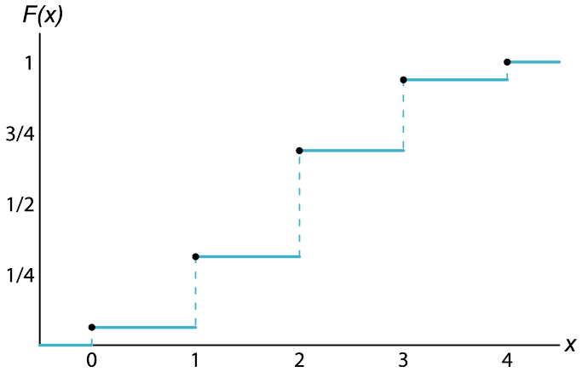
Figure 3.3 Discrete cumulative distribution function

Slide 12
Section 3.3
Continuous Probability Distributions

Slide 13
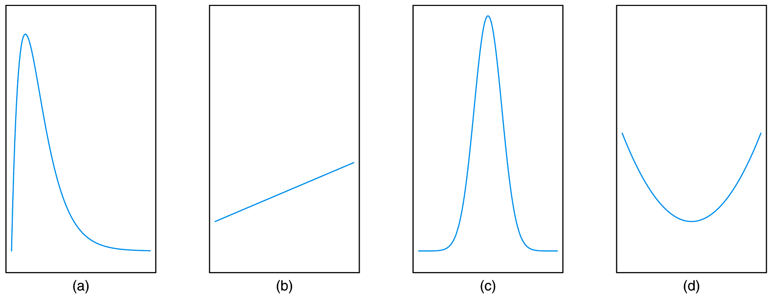
Figure 3.4 Typical density functions

Slide 14
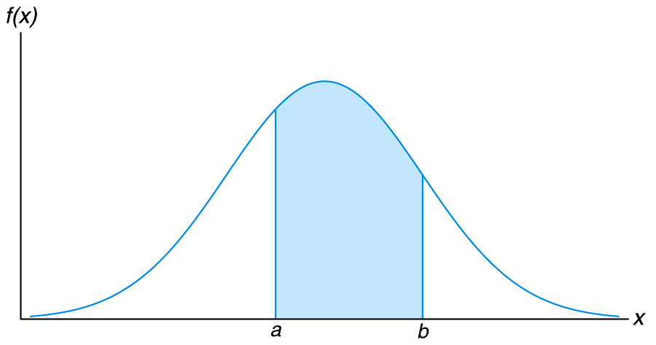
Figure 3.5 P(a < X < b)

Slide 15
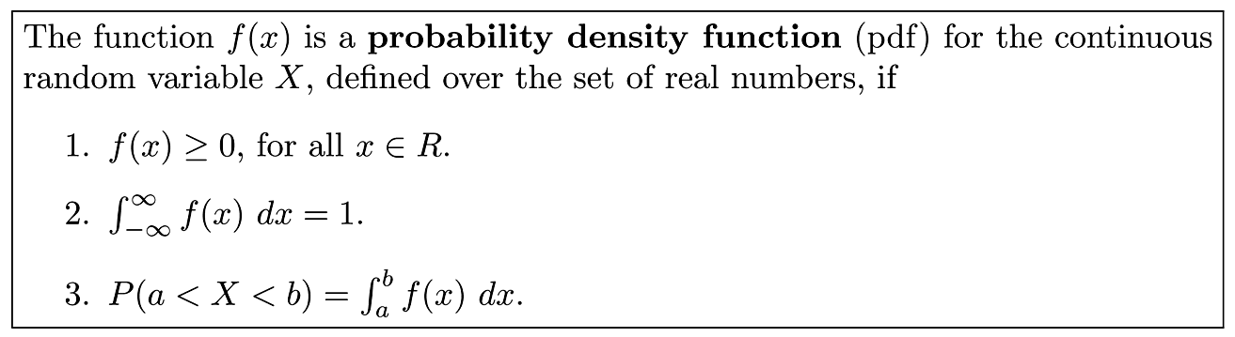
Definition 3.6

Slide 16
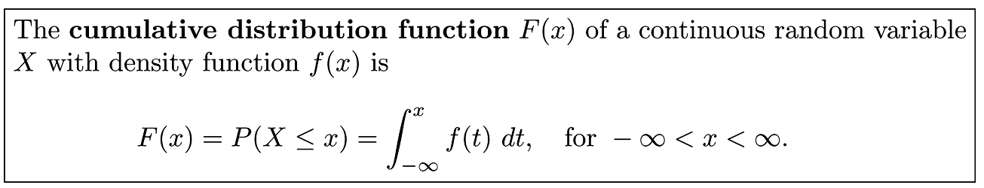
Definition 3.7

Slide 17
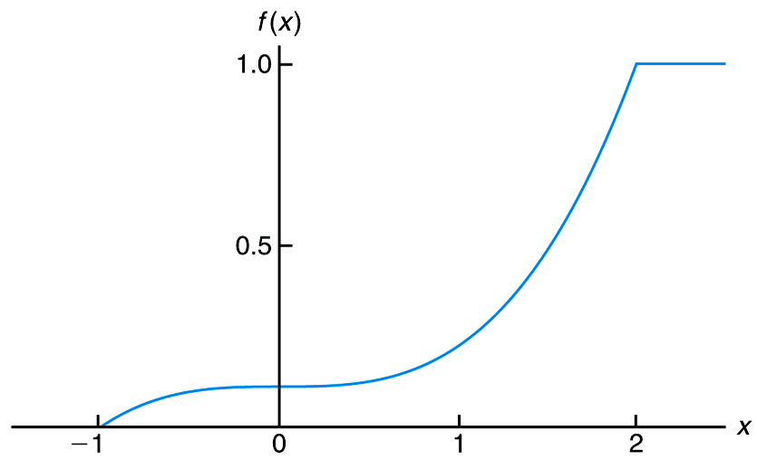
Figure 3.6 Continuous cumulative distribution function

Slide 18
Section 3.4
Joint Probability Distributions

Slide 19
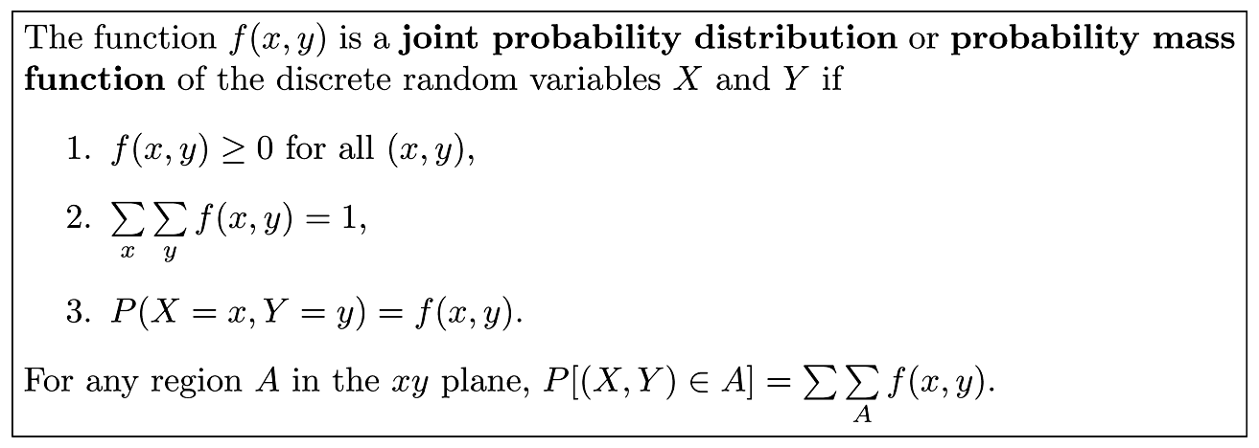
Definition 3.8

Slide 20
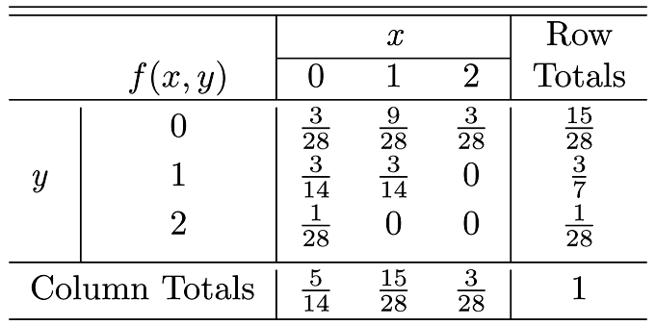
Table 3.1 Joint Probability Distribution for Example 3.14

Slide 21
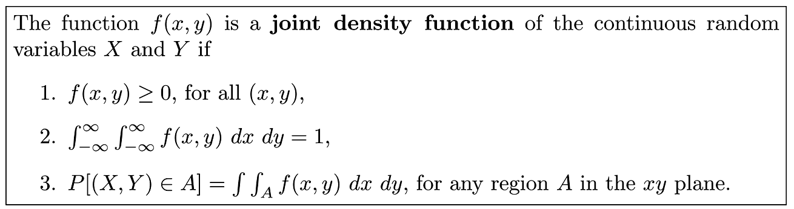
Definition 3.9

Slide 22
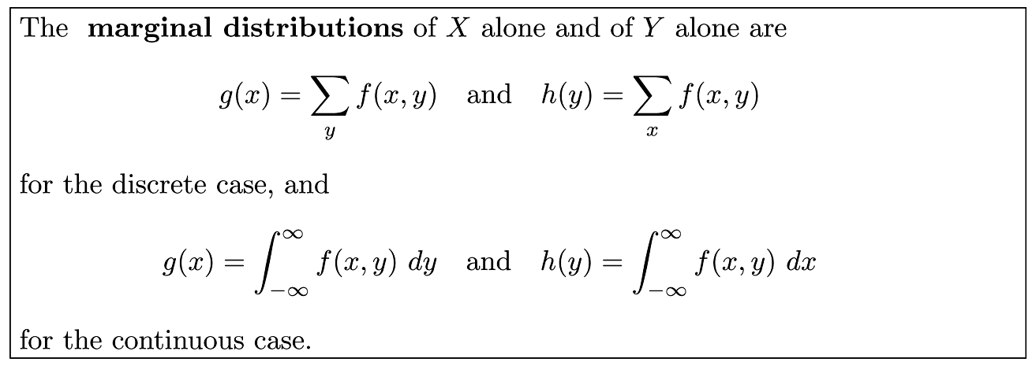
Definition 3.10

Slide 23
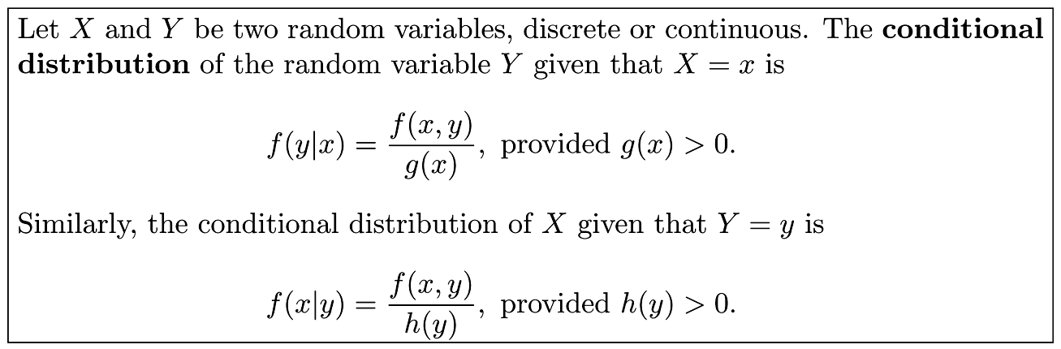
Definition 3.11

Slide 24
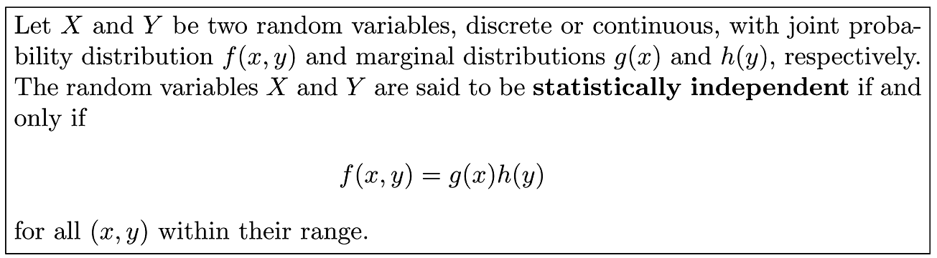
Definition 3.12

Slide 25
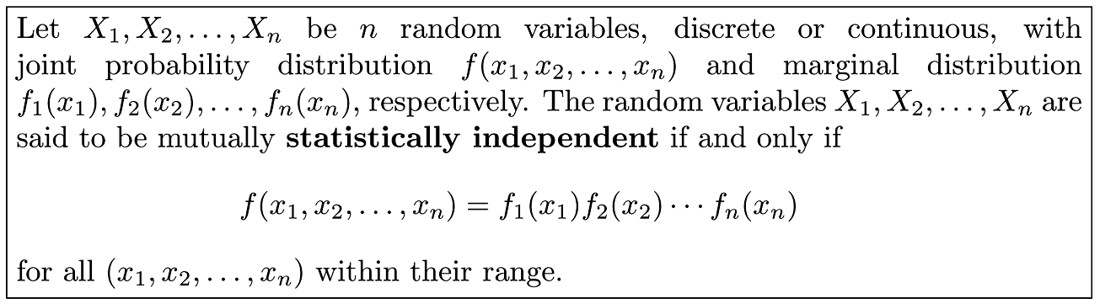
Definition 3.13

Slide 26
Section 3.5
Potential Misconceptions and Hazards; Relationship to Material in Other Chapters

